Slide 1

MICROSOFT PRESENTATION

Slide 2
OVERVIEW
This analysis focuses on how Microsoft can start getting into making movies with a focus on major factors like budgets, ratings, income generated foreign and domestic markets, type of movies(genres) and which studios do best and revenue collected from them per movie among others. This analysis should show the company where they should focus on in order to maximize profits with their given budget.

Slide 3

Importing and loading the required data frames
Viewing the data frames to see what the data carries to know what is required of us in order to solve the business problem for Microsoft
Cleaning the data
Putting the data into visuals that can help us understand the data better
Making conclusions and recommending where best Microsoft can focus on if they decide to engage in this
LAYOUT

Slide 4
DATA FRAME USED
tmdb_movies
movie_gross
imdb_ratings
title_basics
movie_budgets

Slide 5
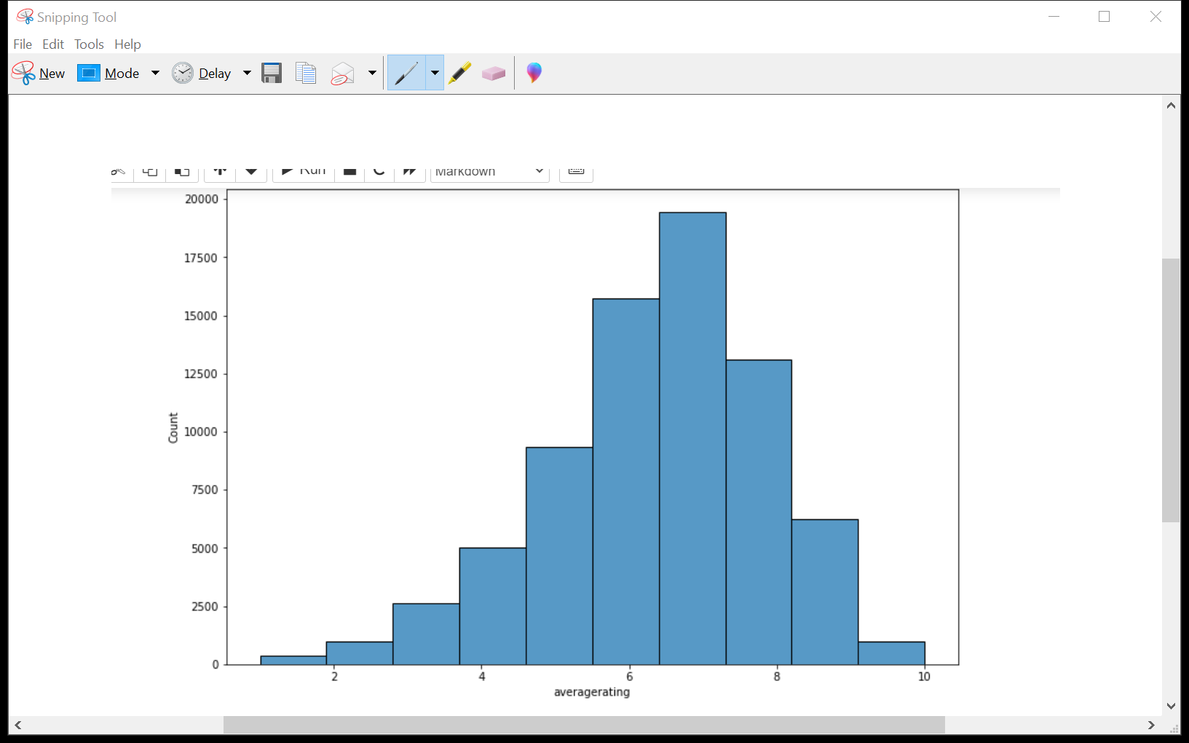
VISUAL 1
From this we are able to see that audience plays a big role in determining if the movie was good and what profits are to be gathered.
Averagely most of the movies have a rating of around 7 , meaning this will be a good determinant while venturing into production

Slide 6
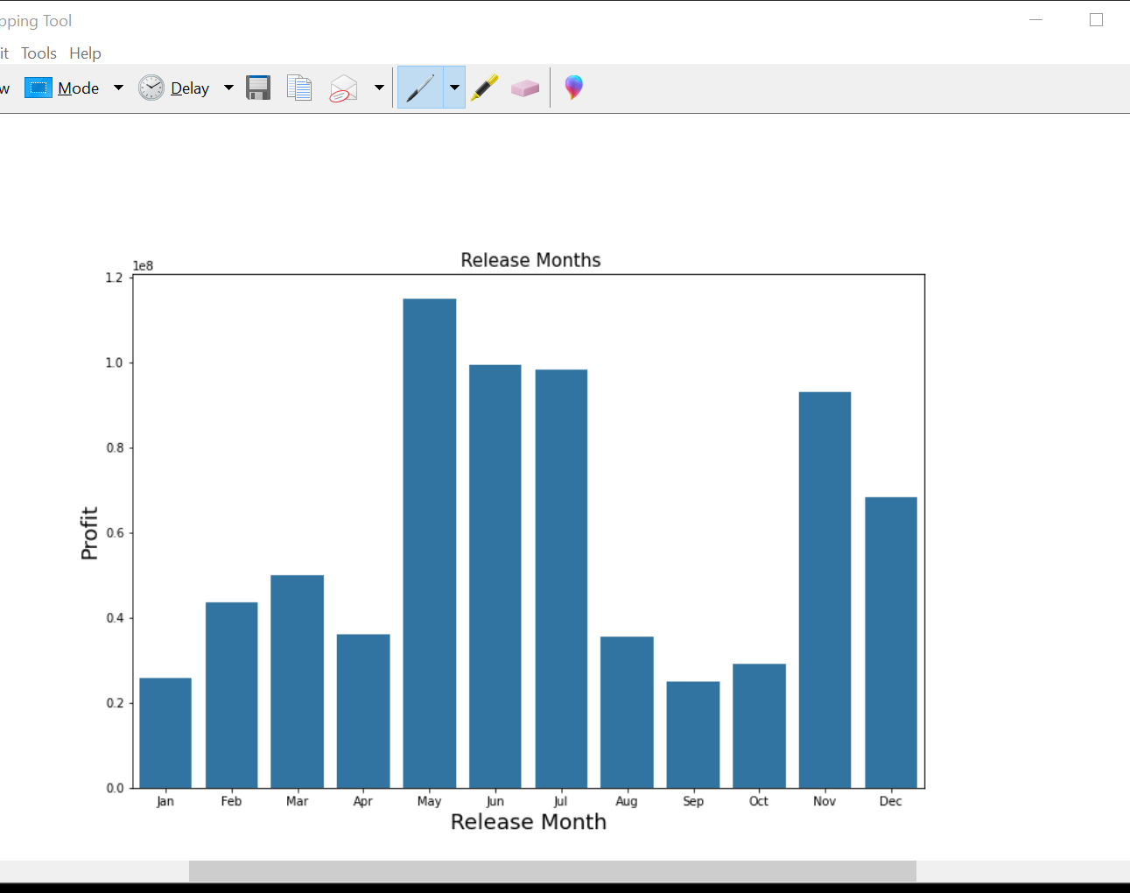
VISUAL 2
This was used to determine the best time to release movies and the profits to be collected at the point of production .

Slide 7
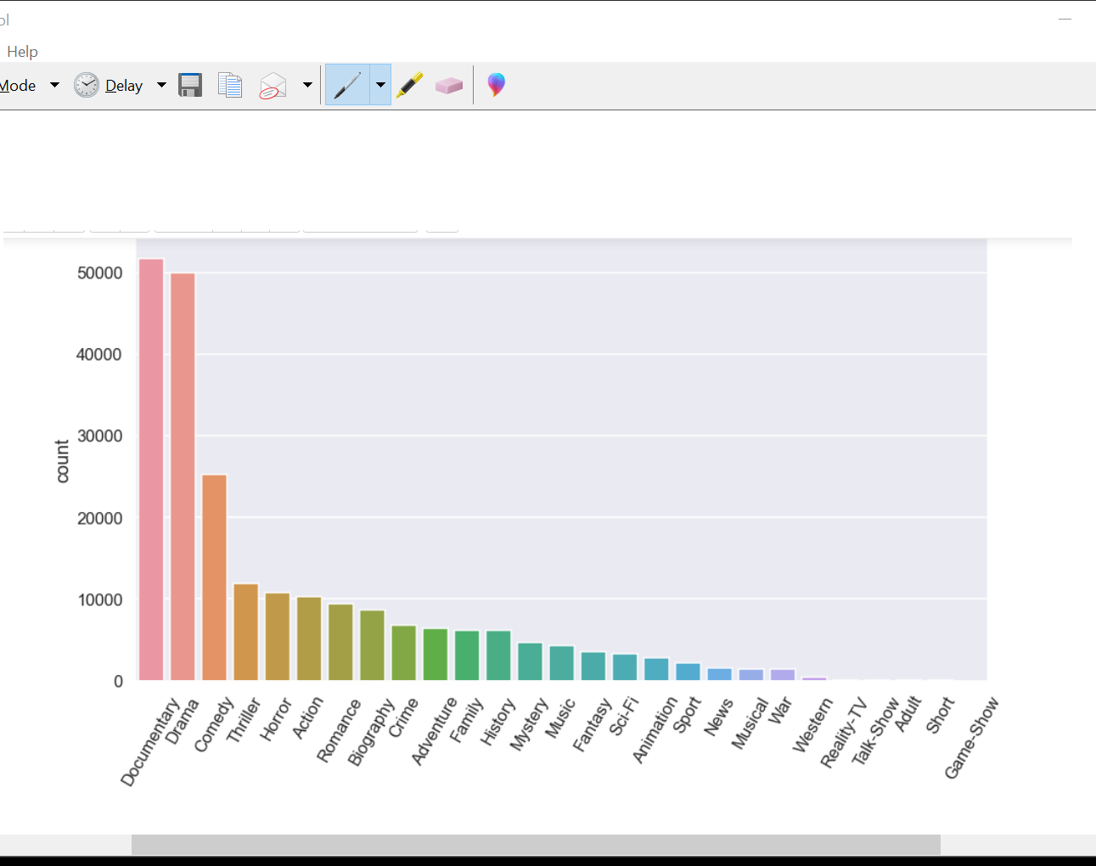
VISUAL 3
Movie genre per count frequently produced movies by the studios. Showing that documentary is the popular one at hand the least being game_show

Slide 8
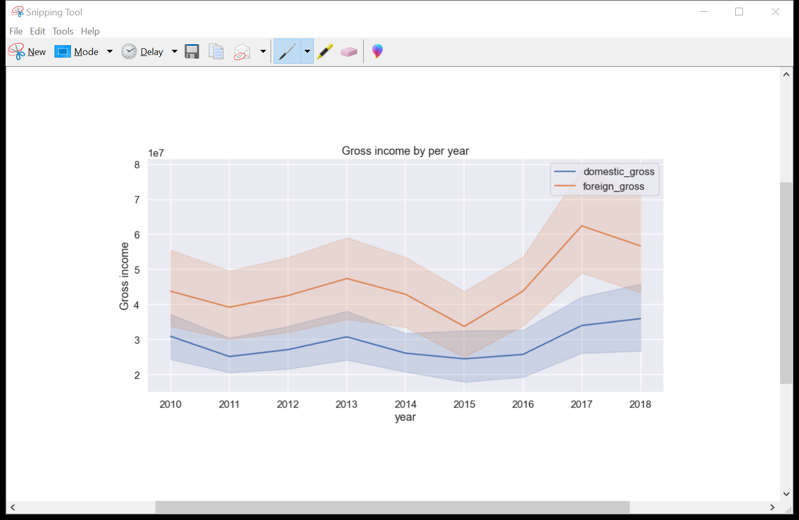
VISUAL 4
Gross income per year of production line graph fluctuations in revenue collected in the various years and which market to produce for with a target audience in mind

Slide 9
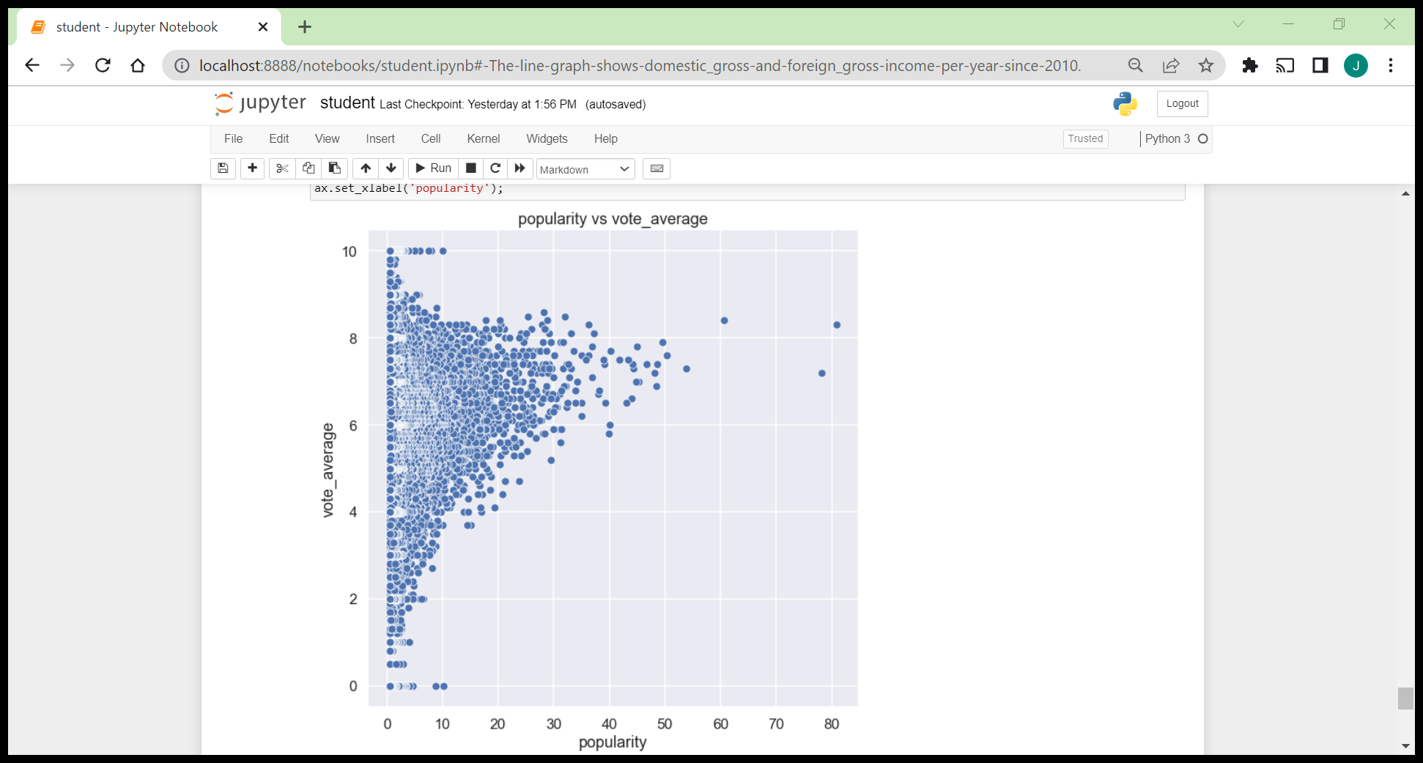
VISUAL 5
This is a scatter plot showing how popularity of the movie can escalate the rating .
Meaning making a movie popular at the markets increases the rating to be around 7 increasing the income earned

Slide 10
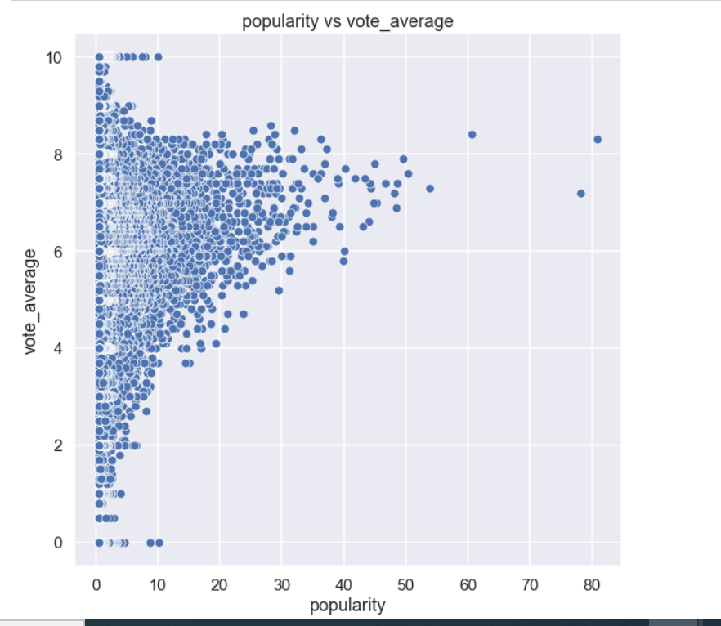
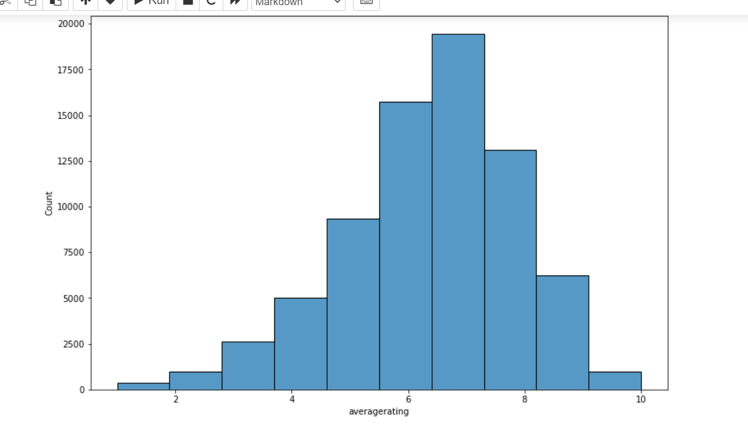
RECOMMENDATION 1
With the audience that Microsoft has, you should ensure you make the movies popular by advertising them more often on your platforms . This will lead to greater profits being generated

Slide 11
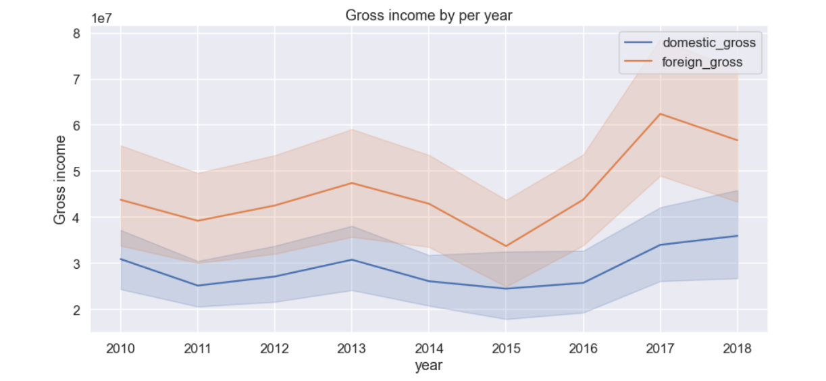
RECOMMENDATION2
As the years pass by from 2010 the foreign markets are seen to get higher profits as compared to domestic. In order to be successful in production focus should be set on the foreign markets to ensure you maximize profits as from the graph

Slide 12
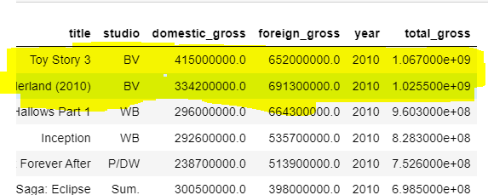
RECOMMENDATION3
Microsoft should use BV studios as a point of reference to see what they did right or wrong since they collected the highest revenue in total gross in the years of production. This will ensure their investment is successful cause of being keen to detail.

Slide 13
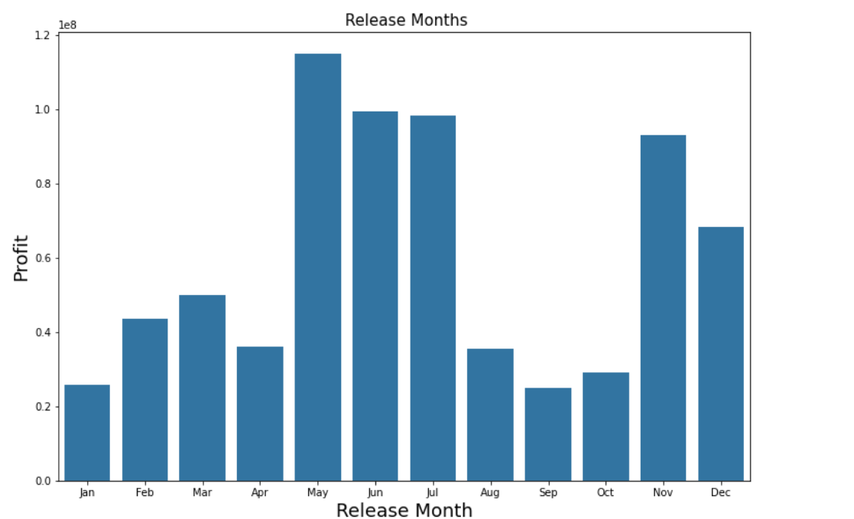
RECOMMENDATION4
If at all they decide to venture into this business, the months to release the movie would be a very big factor to consider to maximize profits. It should be in the months of May-July and year months of Nov-December

Slide 14
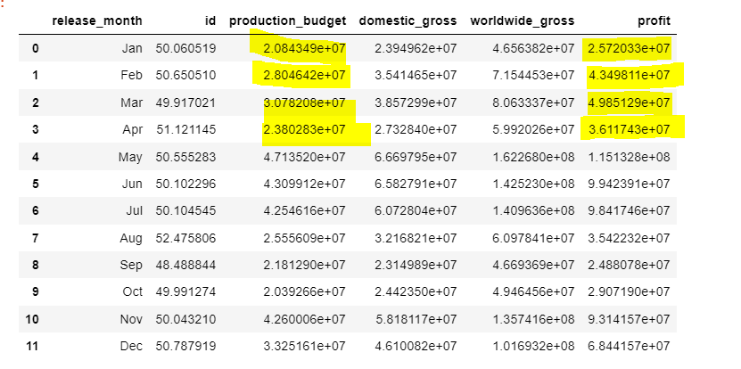
RECOMMENDATION5
I would recommend this business as profitable and worth venturing into if Microsoft is looking into investing to get a good return. Gauging from the profits made from budgets set aside and the actual output which is at least double the investment.

Slide 15
CONCLUSION
In summary, I would recommend Microsoft to venture into movie production gauging from the profits earned from various studios and the audience Microsoft has at the moment. However, they should focus on doing market research looking at audience preference for good ratings, produce for worldwide by diversifying into different genres markets and set aside a good budget plan if they are to succeed.

